Slide 1

Optimization Algorithms
Learning rate
decay
deeplearning.ai

Slide 2
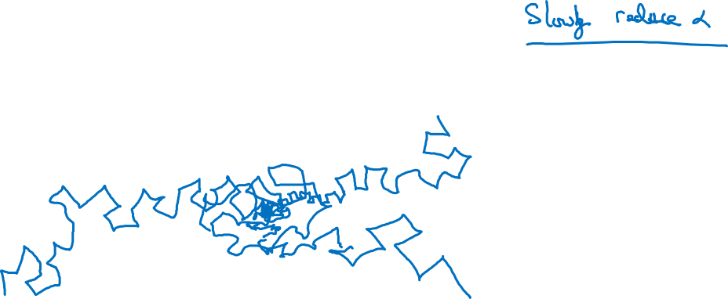
Learning rate decay

Slide 3
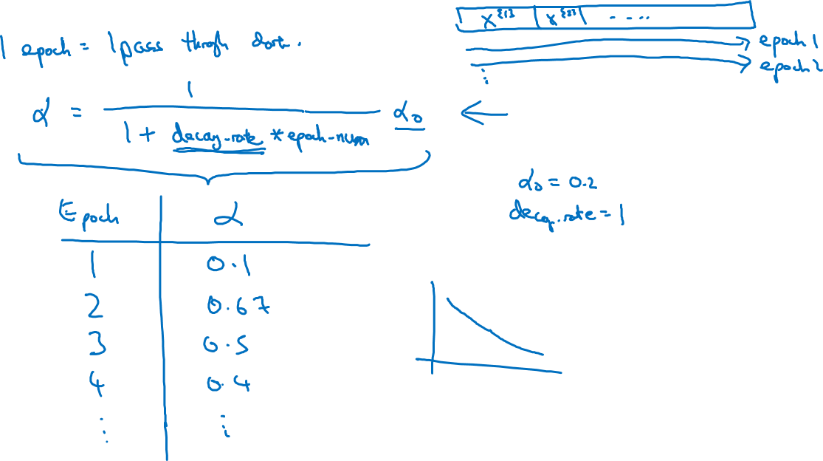
Learning rate decay

Slide 4
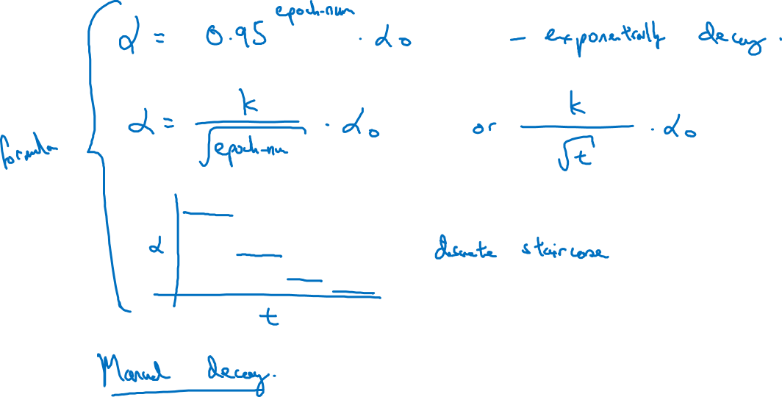
Other learning rate decay methods

